Slide 1
RANGE TREE
IOANNIS-DIMITRIOS STEFANOU

Slide 2
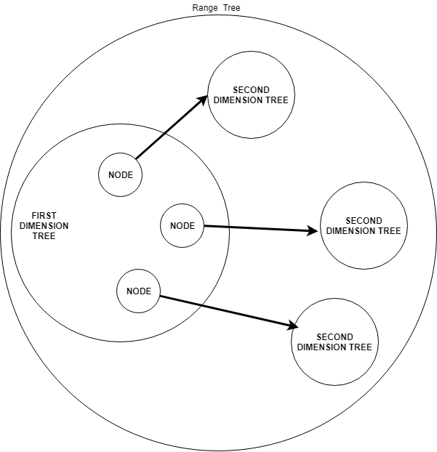
Classes

Slide 3

First we sort our data on the first dimension
6 | 15 | 17 | 21 | 24 | 33 | 42 | 51 | 52 | 57 | 65 | 73 | 78
0 | 1 | 2 | 3 | 4 | 5 | 6 | 7 | 8 | 9 | 10 | 11 | 12
Then we find the middle element and make it our root (42)
(Left + right) / 2 = 6

Slide 4

6 | 15 | 17 | 21 | 24 | 33 | 42 | 51 | 52 | 57 | 65 | 73 | 78
0 | 1 | 2 | 3 | 4 | 5 | 6 | 7 | 8 | 9 | 10 | 11 | 12
Then we find the middle element of the left part and it becomes the left child (21)

Slide 5

6 | 15 | 17 | 21 | 24 | 33 | 42 | 51 | 52 | 57 | 65 | 73 | 78
0 | 1 | 2 | 3 | 4 | 5 | 6 | 7 | 8 | 9 | 10 | 11 | 12
Following this procedure until we reach the left and right pointers are the equal

Slide 6
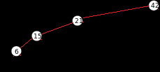
6 | 15 | 17 | 21 | 24 | 33 | 42 | 51 | 52 | 57 | 65 | 73 | 78
0 | 1 | 2 | 3 | 4 | 5 | 6 | 7 | 8 | 9 | 10 | 11 | 12
Following this procedure until we reach the left and right pointers are the equal

Slide 7
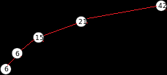
6 | 15 | 17 | 21 | 24 | 33 | 42 | 51 | 52 | 57 | 65 | 73 | 78
0 | 1 | 2 | 3 | 4 | 5 | 6 | 7 | 8 | 9 | 10 | 11 | 12
After reaching a leaf if it is a left child we backtrack and create the right node of the parent

Slide 8
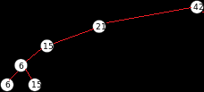
6 | 15 | 17 | 21 | 24 | 33 | 42 | 51 | 52 | 57 | 65 | 73 | 78
0 | 1 | 2 | 3 | 4 | 5 | 6 | 7 | 8 | 9 | 10 | 11 | 12
After reaching a leaf if it is a right child we backtrack and create subtrees for the other dimensions

Slide 9
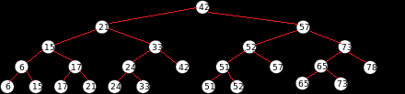
node_contents size n
node_sorting_helper
Size Log<base2> n
node_content_counter=0
node_sorting_helper_counter=0
amount_of_numbers=0

Slide 10
node_contents
Node 6
1
node_sorting_helper
node_content_counter=1
node_sorting_helper_counter=1
amount_of_numbers=0
When we reach a leaf we save the node to the contents and the value 1 in the sort helper

Slide 11
node_contents
Node 6
1
node_sorting_helper
node_content_counter=1
node_sorting_helper_counter=1
amount_of_numbers=0
Also increase the pointers values

Slide 12
node_contents
Node 6 | Node 15
1 | 1
node_sorting_helper
node_content_counter=2
node_sorting_helper_counter=2
amount_of_numbers=0

Slide 13
node_contents
Node 6 | Node 15
1 | 1
node_sorting_helper
amount_of_numbers=node_sorting_helper(counter-2)+(counter-1)
node_content_counter=2
node_sorting_helper_counter=2
When going up from a right child we want to sort the leaves of this node

Slide 14
node_contents
Node 6 | Node 15
1 | 1
node_sorting_helper
node_content_counter=2
node_sorting_helper_counter=2
amount_of_numbers=2
Sort Node contents (content_counter-amount of numbers ) – ( content_counter-1)
Sort Node contents (0) – (1) and then construct a tree using the specific values

Slide 15
node_contents
Node 6 | Node 15
2 | 1
node_sorting_helper
amount_of_numbers=2
node_content_counter=2
node_sorting_helper_counter=2
Save the summary to 2 slots behind the pointer ( 2 – 2 )

Slide 16
node_contents
Node 6 | Node 15
2 | 1
node_sorting_helper
amount_of_numbers=2
node_content_counter=2
node_sorting_helper_counter=1
Decrease the sorting pointer by 1

Slide 17
node_contents
Node 6 | Node 15
2 | 1
node_sorting_helper
amount_of_numbers=2
node_content_counter=2
node_sorting_helper_counter=1

Slide 18
node_contents
Node 6 | Node 15
2 | 1
node_sorting_helper
amount_of_numbers=2
node_content_counter=2
node_sorting_helper_counter=1

Slide 19
node_contents
Node 6 | Node 15 | Node 17
2 | 1 | 1
node_sorting_helper
amount_of_numbers=2
node_content_counter=3
node_sorting_helper_counter=2

Slide 20
node_contents
Node 6 | Node 15 | Node 17
2 | 1 | 1
node_sorting_helper
amount_of_numbers=2
node_content_counter=3
node_sorting_helper_counter=2

Slide 21
node_contents
Node 6 | Node 15 | Node 17 | Node 21
2 | 1 | 1 | 1
node_sorting_helper
amount_of_numbers=2
node_content_counter=4
node_sorting_helper_counter=3

Slide 22
node_contents
Node 6 | Node 15 | Node 17 | Node 21
2 | 1 | 1 | 1
node_sorting_helper
amount_of_numbers=2
node_content_counter=4
node_sorting_helper_counter=3
Sort Node contents (4-2) – (4-1)

Slide 23
node_contents
Node 6 | Node 15 | Node 17 | Node 21
2 | 1 | 1 | 1
node_sorting_helper
amount_of_numbers=2
node_content_counter=4
node_sorting_helper_counter=3

Slide 24
node_contents
Node 6 | Node 15 | Node 17 | Node 21
2 | 2 | 1 | 1
node_sorting_helper
amount_of_numbers=2
node_content_counter=4
node_sorting_helper_counter=2

Slide 25
node_contents
Node 6 | Node 15 | Node 17 | Node 21
2 | 2 | 1 | 1
node_sorting_helper
amount_of_numbers=4
node_content_counter=4
node_sorting_helper_counter=2
Sort Node contents (4-4) – (4-1)

Slide 26
node_contents
Node 6 | Node 15 | Node 17 | Node 21
4 | 2 | 1 | 1
node_sorting_helper
amount_of_numbers=4
node_content_counter=4
node_sorting_helper_counter=1

Slide 27
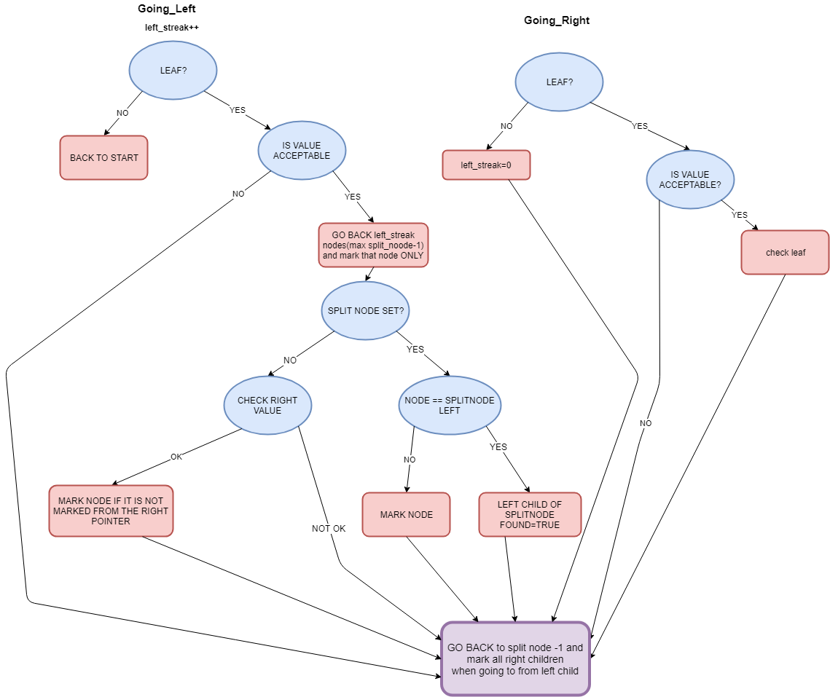
LEFT QUERY POINTER DIAGRAM

Slide 28
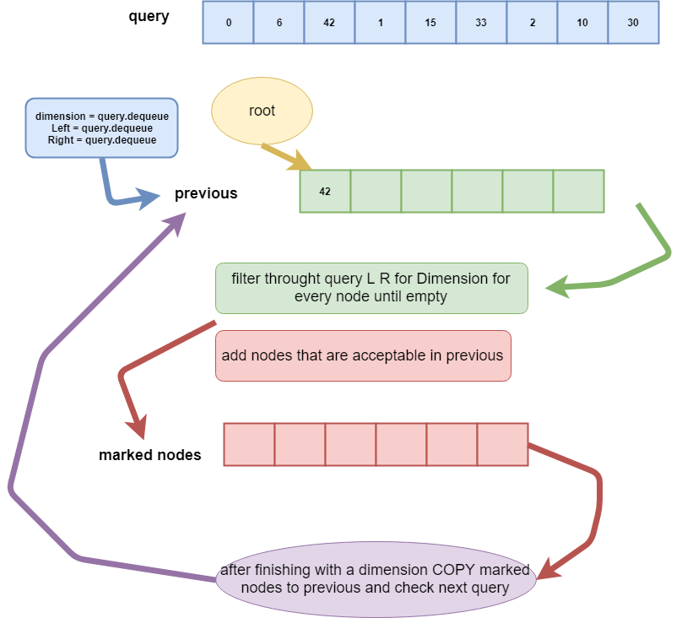

Slide 29
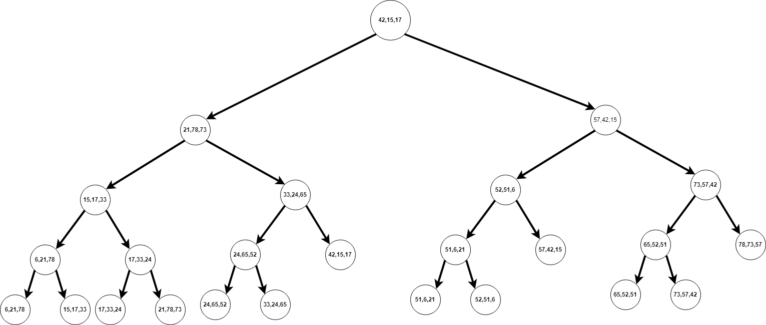
0 | 6 | 42 | 1 | 15 | 33 | 2 | 10 | 30
QUERY QUEUE
42
PREVIOUS NODES QUEUE
Query (6-42,15-33,10-30)

Slide 30
1 | 15 | 33 | 2 | 10 | 30
QUERY QUEUE
42
PREVIOUS NODES QUEUE
Query (6-42,15-33,10-30)

Slide 31
Query (6-42,15-33,10-30)

Slide 32
Query (6-42,15-33,10-30)

Slide 33
Query (6-42,15-33,10-30)

Slide 34
Query (6-42,15-33,10-30)

Slide 35
Query (6-42,15-33,10-30)

Slide 36
Query (6-42,15-33,10-30)

Slide 37
Query (6-42,15-33,10-30)

Slide 38
21
PREVIOUS NODES QUEUE
MARKED NODES QUEUE
Query (6-42,15-33,10-30)

Slide 39
21
PREVIOUS NODES QUEUE
MARKED NODES QUEUE
Query (6-42,15-33,10-30)

Slide 40
1 | 15 | 33 | 2 | 10 | 30
21
QUERY QUEUE
PREVIOUS NODES QUEUE
Query (6-42,15-33,10-30)

Slide 41
2 | 10 | 30
21
QUERY QUEUE
PREVIOUS NODES QUEUE
Query (6-42,15-33,10-30)

Slide 42
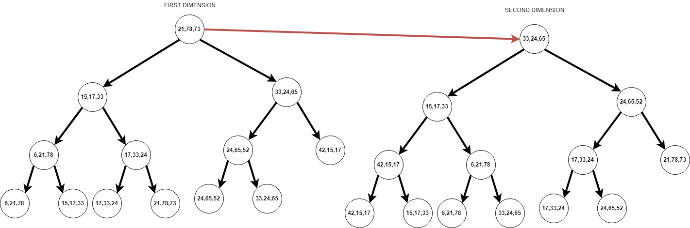
21
PREVIOUS NODES QUEUE
Query (6-42,15-33,10-30)

Slide 43
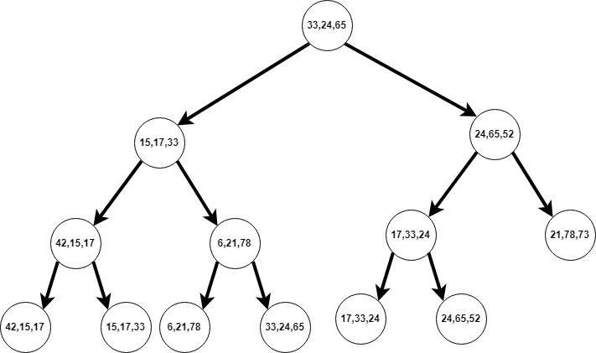
Query (6-42,15-33,10-30)

Slide 44
Query (6-42,15-33,10-30)

Slide 45
Query (6-42,15-33,10-30)

Slide 46
Query (6-42,15-33,10-30)

Slide 47
Query (6-42,15-33,10-30)

Slide 48
Query (6-42,15-33,10-30)
33
MARKED NODES QUEUE

Slide 49
Query (6-42,15-33,10-30)
33 | 17
MARKED NODES QUEUE

Slide 50
Query (6-42,15-33,10-30)
33 | 17
PREVIOUS NODES QUEUE
2 | 10 | 30
QUERY QUEUE

Slide 51
Query (6-42,15-33,10-30)
33 | 17
PREVIOUS NODES QUEUE
QUERY QUEUE

Slide 52

Query (6-42,15-33,10-30)
Check leaf with left right10-30 for next dimension
24
MARKED NODES QUEUE

Slide 53
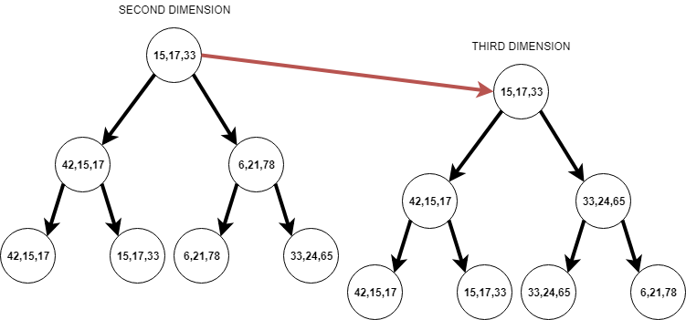
Query (6-42,15-33,10-30)

Slide 54
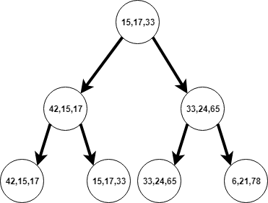
Query (6-42,15-33,10-30)

Slide 55
Query (6-42,15-33,10-30)

Slide 56
Query (6-42,15-33,10-30)

Slide 57
Query (6-42,15-33,10-30)
24 | 17
MARKED NODES QUEUE

Slide 58
Query (6-42,15-33,10-30)
24 | 17
MARKED NODES QUEUE
24 | 17
RESULTS
PREVIOUS NODES QUEUE
QUERY QUEUE

Slide 59
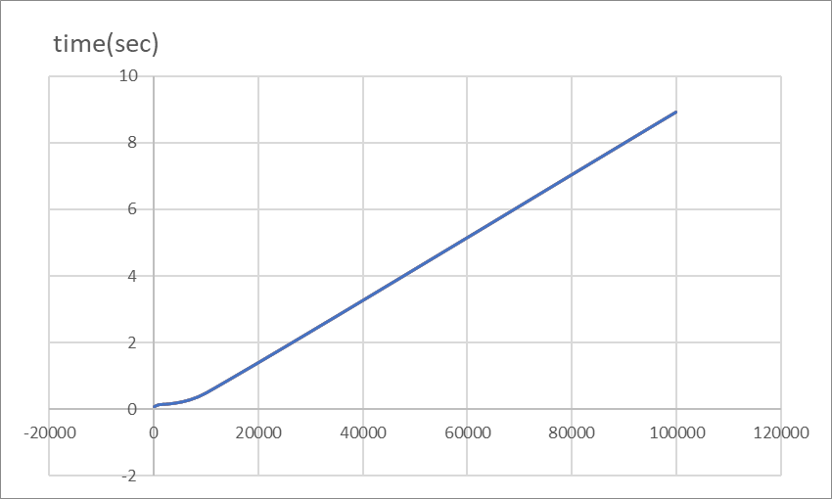
TIME – ITEMS Diagram (3 dimensions)

